Slide 1

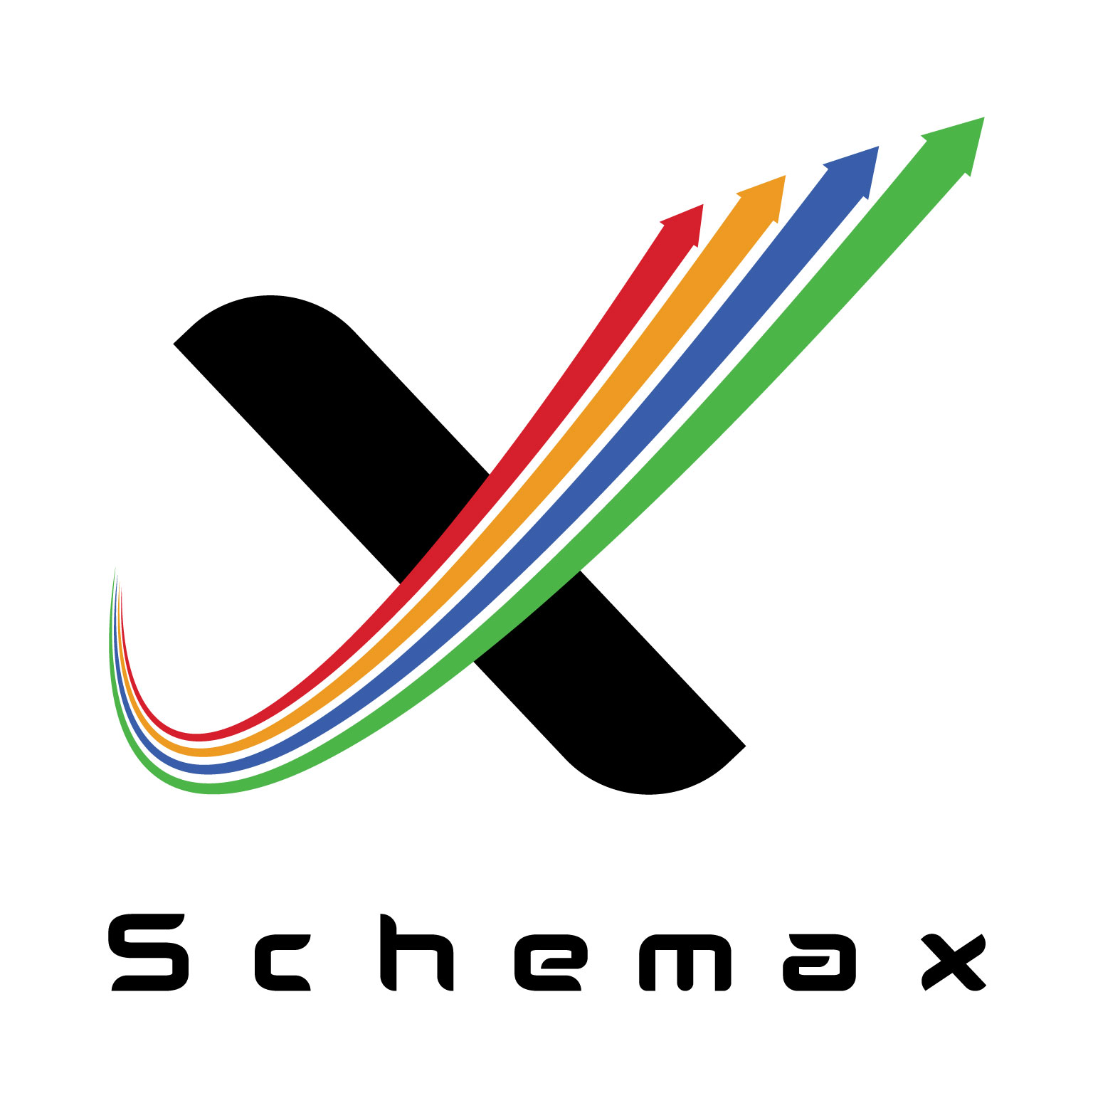

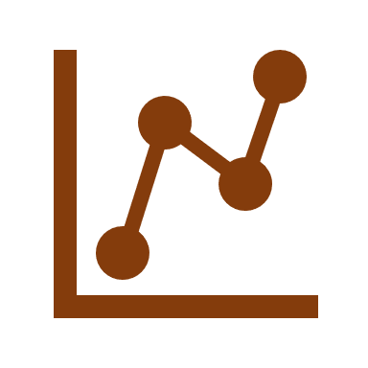


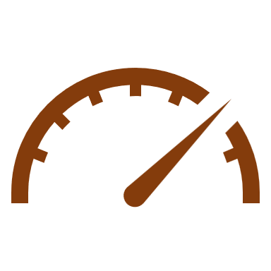
Synergize Product Development and Sample room operations
Startex synergizes product development and sample room operations into an efficient workflow that
enhances productivity and quality for faster and accurate PD & sample delivery.
Business Benefits
Increase the order visibility at PD 100%
Enhances Employee Productivity by 30%
Streamlining of Sample room operations by 100%
Improve overall ROI by 20%
Less human intervention and no dependency on hierarchy, enabling seamless function of all related parties for multiple locations assets management.
Employees are more focused on the process rather than firefighting on manual documentation and reconciliation
Promotes digital way of working and keeping records, thus reducing paper based evidence for assets management including compliances and annual audits.
When all related resources are optimized, there is significant financial benefits across all cross functional departments which lead to improved return on investments
REAL IMPACT ON OUR EXISTING CUSTOMERS
10+ Locations
managed on cloud - real time
complete PD & Sample room management system
10k+ Multiple
assets in all class including depreciation reports
+8k Maintenance
jobs triggered annually without human intervention
$100k+ Savings
on preventive maintenance &
assets optimization

Slide 2


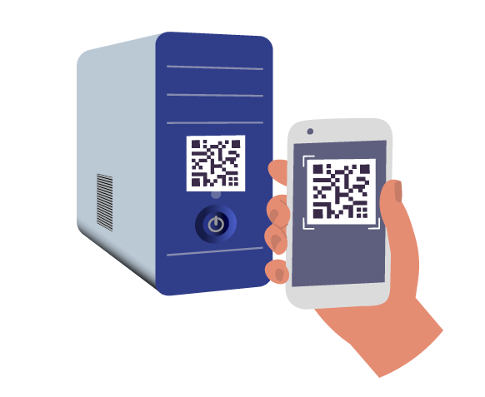

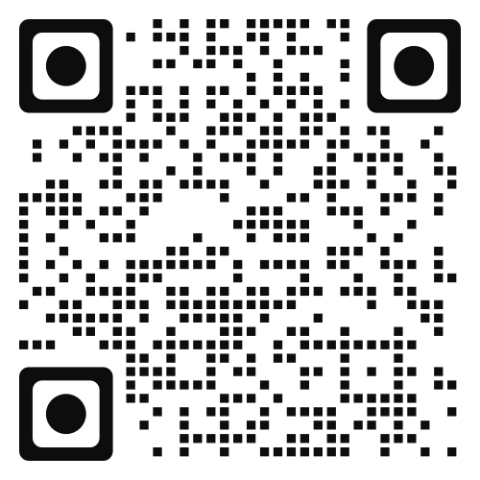
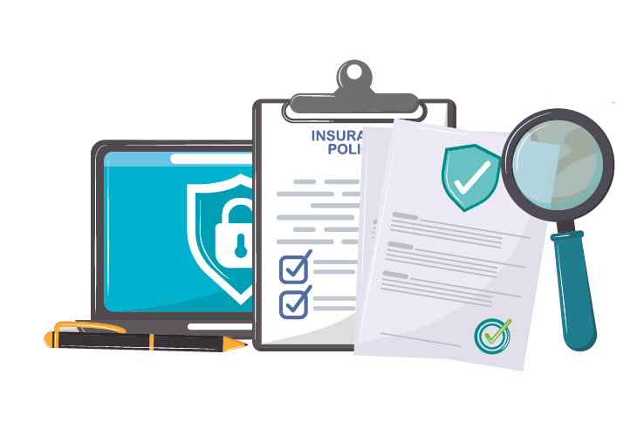



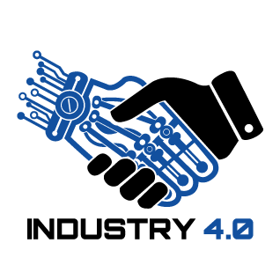








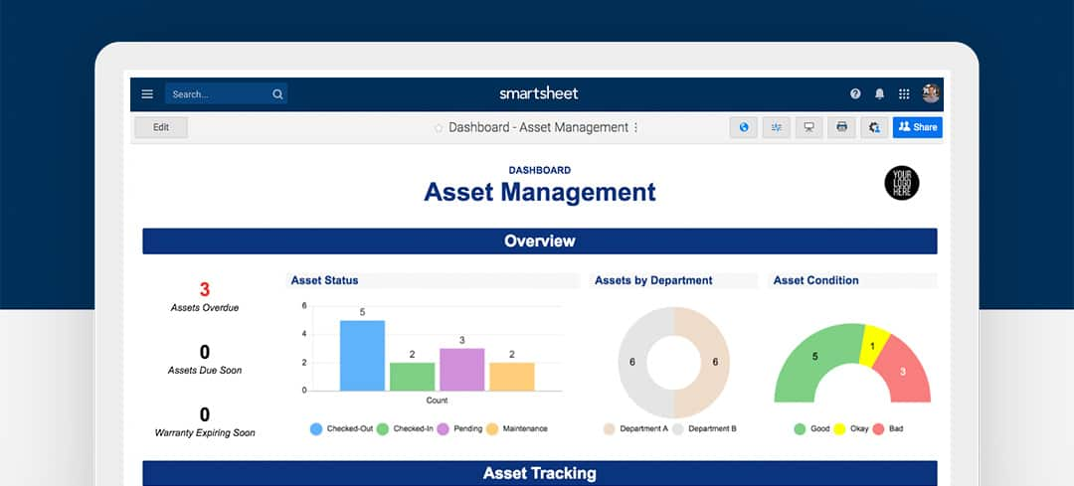
Integrate Assets, Process and People
Suitable for any entity including Apartments, Gated communities, Hospitals, Factories and many more..
Key Features
Indent management for uninterrupted operations.
WARRANTY & INSURANCE management for cost optimization.
Follow us on
Purchase with QR & Bar
codes for efficient management.
RACI MATRIX for better financial governance & audits.
LICENSE AND SERVICE AGREEMENT management for better utilization of AMCs.
MULTIPLE Location management of assets.
DOWNTIME TRACKING for proactive preventive measures.
INTEGRATION with
WHATS-APP for feedback.
CRITICAL ALERTS & ESCALATION SYSTEM for operational excellence.
DEPRECIATION & AUDIT annual reports.
REAL TIME DASH BOARDS for easy monitoring and tracking of Assets.
ROOT CAUSE ANALYSIS for problem solving.
OUR VALUED CUSTOMERS
GATED COMMUNITY
VARUN Group
DEMO | TRIAL | YEAR AROUND SUPPORT SERVICES
info@schemaxtech.com
https://www.schemaxtech.com

